Slide 1
Economic Development in the Philippines:
High Potential, Big Challenges, Wide Impact
By
John D. Forbes
Senior Adviser, The Arangkada Philippines Project
The American Chamber of Commerce of the Philippines, Inc.
November 19, 2014
Southeast Asia Wednesday Lunch Program
School for Advanced International Studies
Washington, DC

Slide 2

Proposition:
A country with High Potential
that can surmount its Big Challenges
can have Wide Impact

Slide 3

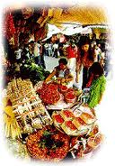
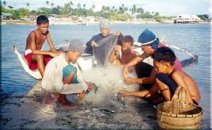


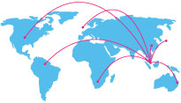
High Potential
Human resources
  Large population (100 million)
  Demographic dividend - young (53% <24* years)
  English-speaking (largely) and friendly
  To grow to world’s 10th most populous (140 million)
Natural resources
  Minerals - $1.4 trillion in mining reserves (copper, gold, nickel, iron, uranium)
  Marine
  Agriculture
Location: world’s fastest growing region
Note: 2014 est., NSO; CIA World Factbook
Notes:
Note: To JDF, do you still want to superimpose the growth rates of other ASEAN-6?

Slide 4
Strong GDP Growth; Could be Higher

Slide 5
Rising Remittances Contribute Almost 10% to GDP
Notes:
Note/s: GDP value used at current 2000 prices

Slide 6


Becoming More Competitive
Survey | Year | 2013 Ranking | 2014 Ranking | Trend | Previous ASEAN-6 Ranking | 2014 ASEAN-6 Ranking | Trend | Date of Previous Press Release | (Est.) Date of Next Release | Sources
1. Best Countries for Business | 2013 | 90 of 145 | No update | No Update | 5 of 6 | No Update | No Update | Dec. 2013 | Dec. 2014 | Forbes Magazine
2. Fragile States Index¹ | 2014 | 59 of 178 | 52 of 178 | Deteriorated | 6 of 6 | 6 of 6 | Stable | Jun. 24, 2014 | Jun. 24, 2015 | Foreign Policy Magazine / The Fund for Peace
3. Index of Economic Freedom | 2014 | 97 of 177 | 89 of 178 | Improved | 4 of 6 | 4 of 6 | Stable | Jan. 14, 2014 | Jan. 10-14, 2015 | Heritage Foundation / Wall Street Journal
4. World Competitiveness Yearbook | 2014 | 38 of 60 | 42 of 60 | Deteriorated | 5 of 5² | 5 of 6 | Deteriorated | 22-May-14 | May 22-30, 2015 | International Institute of Management Development
5. International Property Rights Index | 2013 | 77 of 131 | Removed from list | N/A | 4 of 6 | N/A | N/A | Sept. 2014 | Sept. 2015 | Property Rights Alliance
6. Corruption Perception Index | 2013 | 94 of 177 | No update | No update | 3 of 6 | No Update | No Update | Dec. 2013 | Dec. 2014 | Transparency International
7. Human Development Report | 2014 | 114 of 186 (2012) | 117 of 187 (2013) | Stable | 4 of 6 (2012) | 4 of 6 (2013) | Stable | 24-Jul-14 | Mar. or July 2015 | United Nations Development Programme
8. E-Government Readiness Survey⁵ | 2014 | 88 of 190 (2012) | 95 of 193 | Deteriorated | 4 of 6 (2012) | 3 of 6 | Improved | Jun. 24, 2014 | Mar. or Jun. 2016 | United Nations Public Administration Network
9. Doing Business⁶ | 2014 | 108² of 189 (2013-2014) | 95 of 189 (2014-2015) | Improved | 5 of 6 | 5 of 6 | Stable | Oct. 29, 2014 | Oct. 23-30,2015 | World Bank
10. Investing Across Borders⁷ | 2010 | N/A | N/A | No Update | N/A | N/A | N/A | Jul. 7, 2010 | Before end of 2012 | World Bank
11. Paying Taxes¹² | 2013 | 131 of 189 (2013-2014) | No update | No Update | 4 of 6 | No Update | No Update | Nov. 19, 2013 | Nov. 19-21,2014 | World Bank
12. Global Competitiveness Report | 2013 | 59 of 148 | 52 of 144 | Improved | 5 of 6 | 5 of 6 | Stable | Sept. 3, 2014 | Sept. 3-4, 2015 | World Economic Forum
13. Global Enabling Trade Report⁸ | 2012 | 72 of 132 (2012) | 64 of 138 | Improved | 6 of 6 | 5 of 6 | Improved | 25-Mar-14 | Mar. or May, 2016 | World Economic Forum
14. Travel & Tourism Competitiveness⁹ | 2013 | 82 of 140 | No Update | No Update | 4 of 6 | No Update | No Update | Mar. 7, 2013 | Mar. 2015 | World Economic Forum
15. Environmental Performance Index¹⁰ | 2012 | 42 of 132 (2012) | 117 of 178³ | Deteriorated | 3 of 6 (2012) | 5 of 6 | Deteriorated | Jan. 25, 2014 | Jan. 25, 2016 | Yale Center for Environmental Law and Policy
Notes:
*Note:
¹Survey title changed to avoid controversy/offensement and instead highlight human security
²DB2014 ranking shown is not last year’s published ranking but a comparable ranking for DB2014 that captures the effects of such factors as data corrections and the changes in methodology.
³ EPI reflects methodological change and additional in total population of countries surveyed

Slide 8
Notes:
Source: World Bank , 2013-2014 ranking of 86th is not the published ranking of the Philippines, but is a result of revisions in methodology, hence the country’s decline in ranking from 86th in 2013-2014 to 95th in 2014-2015

Slide 10
Rising Foreign Direct Investment

Slide 11
BPO Sector Reaches One Million
growth
1.3^{million}
direct employment
by 2016
by the numbers
Source: IBPAP
Notes:
The BPO sector targets to employ 1.3 million people by the end of 2016 With a multiplier effect, it is expected that an additional 3.2M jobs will be generated to support the industry

Slide 12
…and contributes Million
25 ^{billion}
US$
2016 IT-BPM Revenue
by the numbers
Source: IBPAP

Slide 13
Philippines BPO 2013 Performance
 | FTEs | Revenue (US$M) | Rev % inc. fr ’12
Voice BPO | 586,000 | 10,000 | 15%
Non-voice BPO/KPO | 169,818 | 2,915 | 18%
ITO | 71,196 | 1,767 | 52%
Health Info Mgt & Care | 65,895 | 988 | 114%
Engineering Services | 11,920 | 216 | 5%
Animation | 9,200 | 132 | 0%
Game Development | 3,500 | 50 | 0%
TOTAL FTEs | 917,529 | 16,067 | 22%
Philippine IT-BPM industry size
2006–2013; US$ billion
x%
YoY Growth
CAGR: ~25%
22%
19%
24%
25%
34%
17%
31%
45%
# FTEs
(~‘000)
236
298
371
424
527
640
777
917
Global share¹
5%
6%
6%
7%
8%
9.5%
10.4%
11%
1 Philippines IT-BPM market as percentage of global offshore services market, in revenue terms
Sources: BPAP, ACPI, CCAP, GDAP, HIMOAP, PSIA
Copyright ©2012: BPAP. All rights reserved.
Notes:
This chart shows the performance of the industry in 2012, showing a growth of 19% year on year. Notable items:
The Voice sector continues to be number one in the world, employing 487K
The IT Outsourcing sector breached the US1 Billion mark in 2012
The healthcare sector grew 66% in 2012
Game development may be the smallest but has tremendous potential, growing 251%

Slide 14
Manufacturing Growing

Slide 15
Tourism Growth: Foreign
Source: ASEAN Tourist Statistics Database;
Note: The Philippines received 4.6 Mn foreign tourists in 2013 and 3.3 Mn as of August 2014

Slide 16
Tourism Growth: Domestic
Source: Civil Aviation Board

Slide 17
Big Challenges: Poverty/Inclusive Growth

Slide 18
Poverty (National Standard) Declining:
Trickle Down and CCT
Poverty incidence declined to 24.9 percent in the first semester of 2013 from 27.9 percent for the same period in 2012. This translates to about 2.5 million people lifted out of poverty.
Source: PSA-LFS
Note: Poverty incidence, as defined by PSA, refers to portion of the popultion who earn income below the average individual income enough to cover aggregate spending on basic needs: clothing, food, shelter, etc.; in H1 2013, povety per capita threshold was at PhP9,626 per month
Notes:
Balisacan’s note at Aug. 26 AmCham GMLM:
“Importantly, we are beginning to see encouraging signs that the country’s economic development, coupled with more aggressive social protection policies, are starting to reduce poverty at a faster rate. The four consecutive quarters of higher than 7 percent growth in real GDP from the second half of 2012 to the first half of 2013 translated to a significant reduction in poverty incidence during the period. Poverty incidence among Filipinos, or the proportion of people below the poverty line registered a 3.0 ppt drop, coming from 27.9 percent in the first semester of 2012 to 24.9 percent in the first semester of 2013. This translates to about 2.5 million people lifted out of poverty.
Meanwhile, the proportion of Filipinos in extreme poverty also posted strong decline, from 13.4 to 10.7 percent during the same period.
Notwithstanding this accomplishment, we are aware of the need to further accelerate poverty reduction, thereby fulfilling the President’s Social Contract of inclusive growth.”

Slide 19
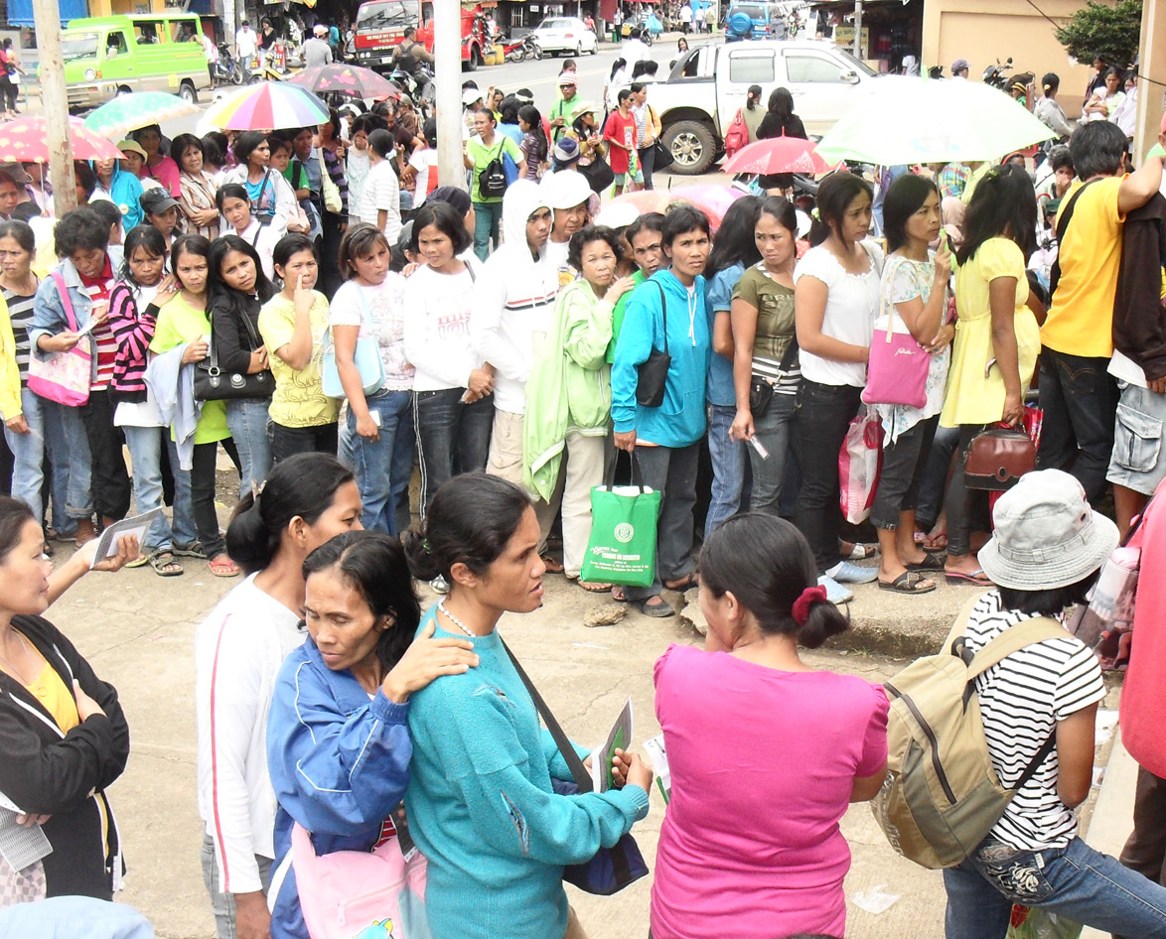
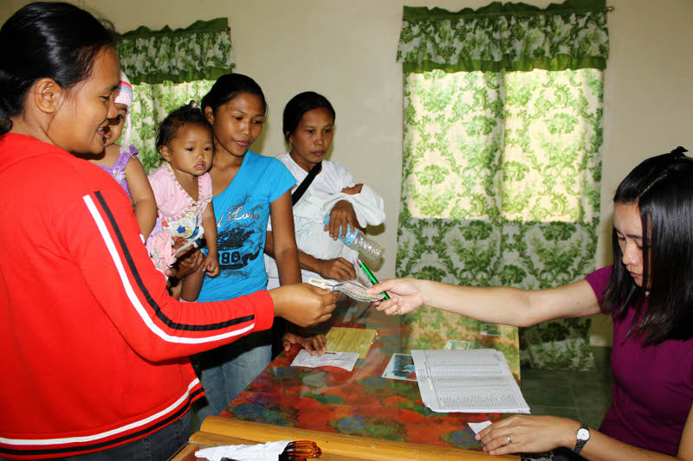
Investment in Human Capital/Social Infrastructure
 | 2010 (PhP Bn) | 2015 (PhP Bn) | % Change
Education | 171 | 319 | 87%
Health | 28 | 87 | 211%
CCT | 10 | 64 | 540%
Source: National Expenditure Program, Department of Budget and Management

Slide 20
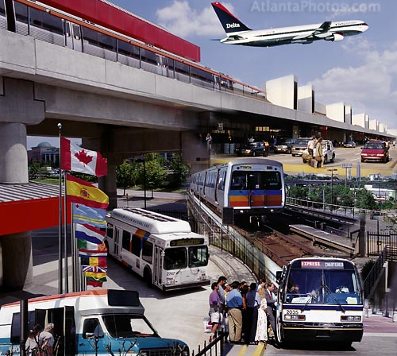
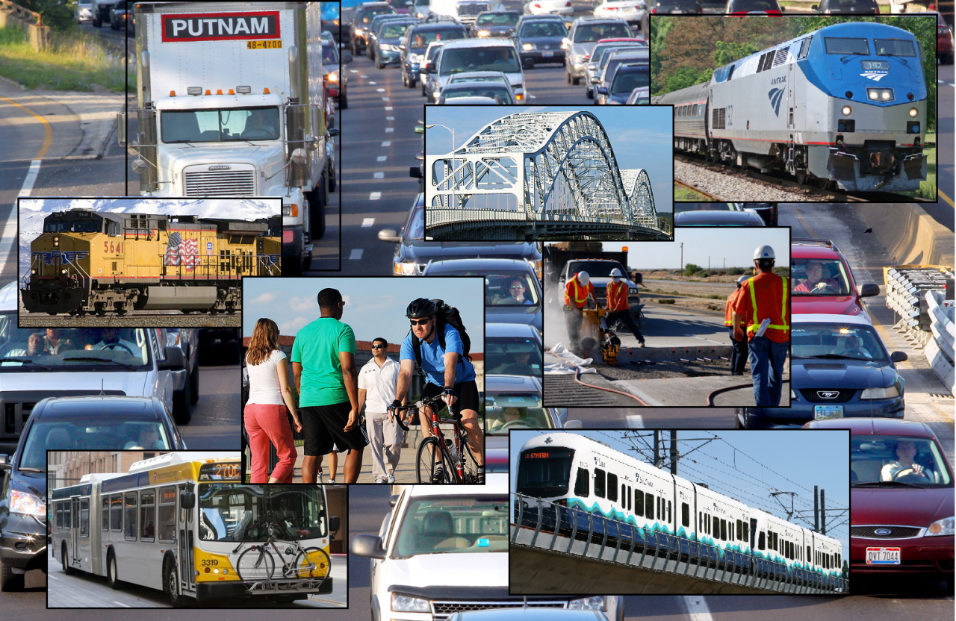
WEF Infrastructure Rankings, ASEAN-6,, 2013-14
ASEAN-6 | Overall | Airport | Rail | Road | Seaport | Telecomm* | Power
Singapore | 5th of 144 | 1st | N/A | 6th | 2nd | 17th | 6th
Malaysia | 20th of 144 | 19th | 12th | 19th | 29th | 30th | 39th
Indonesia | 72nd of 144 | 64th | 41st | 72nd | 77th | 54th | 84th
Thailand | 76th of 144 | 37th | 74th | 50th | 54th | 34th | 58th
Philippines | 95th of 144 | 108th | 80th | 87th | 101st | 86th | 87th
Vietnam | 112nd of 144 | 87th | 52nd | 104th | 88th | 42nd | 88th
Source: WEF Global Competitiveness Report (GCR) 2014-2015;
Note: N/A is used for economies where there is no regular train service or where the network covers only a negligible portion of the territory; it may also be noted that early this year, the Singaporean gov’t has announced plans to expand its railway network, possibly impacting the assessment done by the WEF; *Mobile telephone subscriptions/100 population
Notes:
Note:

Slide 21
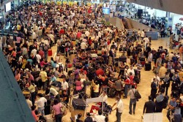
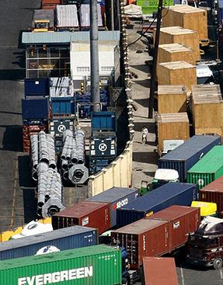
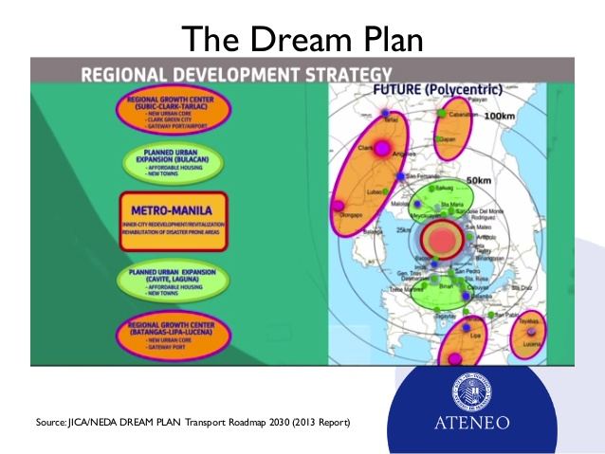
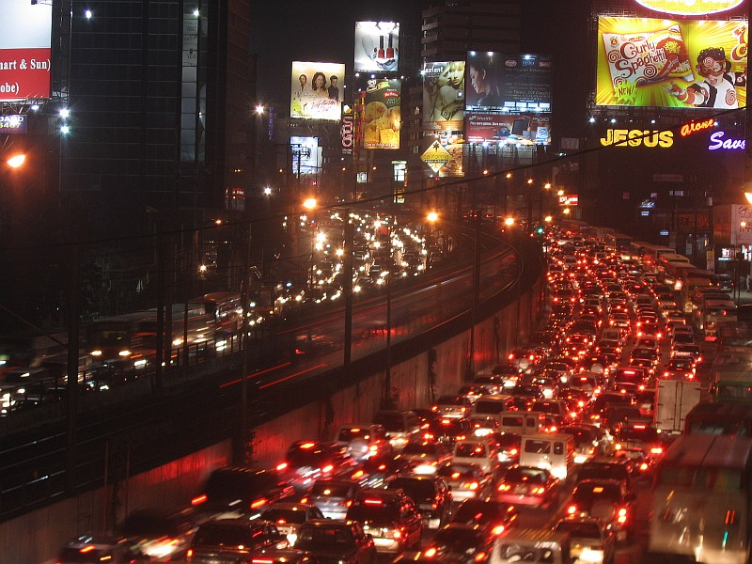
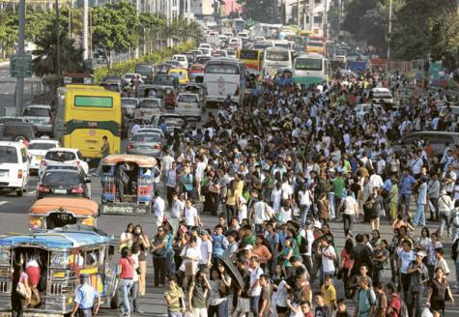
Congestion Challenges
Port of Manila
NAIA
Traffic
Dream Plan
  $60B over 10 yrs.
  road → rail

Slide 22
Investment in Physical Infrastructure
Increase Infrastructure Spending:
Increase infrastructure spending from 2.6% to at least 5% of GDP by 2016
Notes:
Note

Slide 23
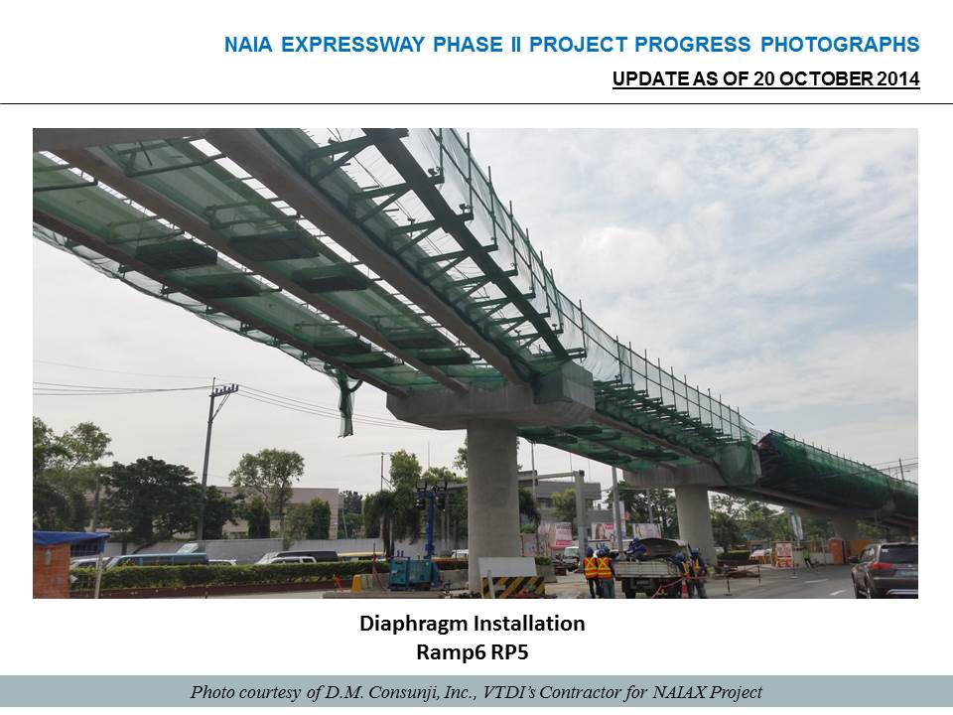
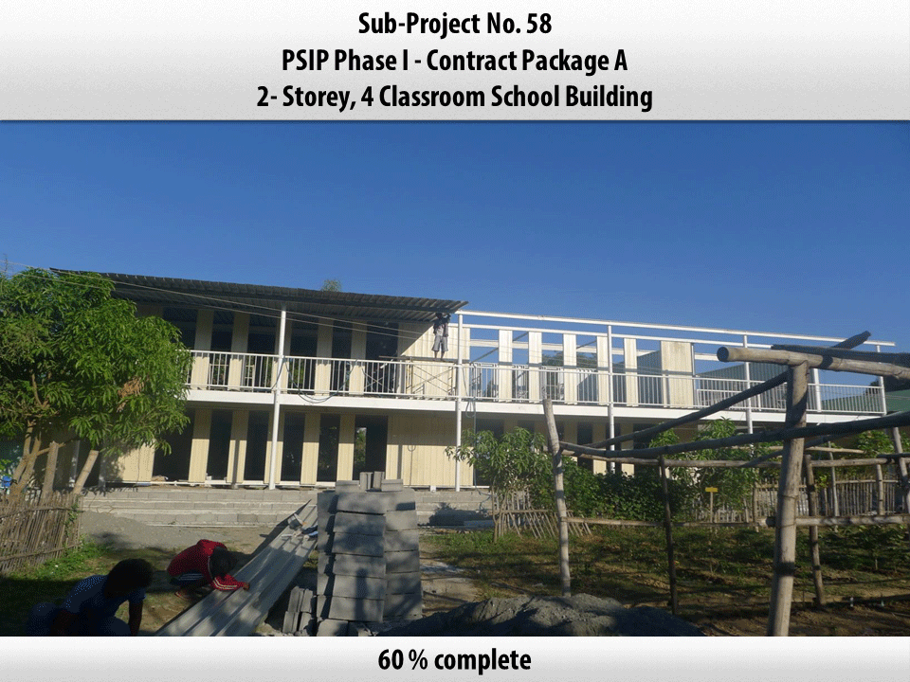
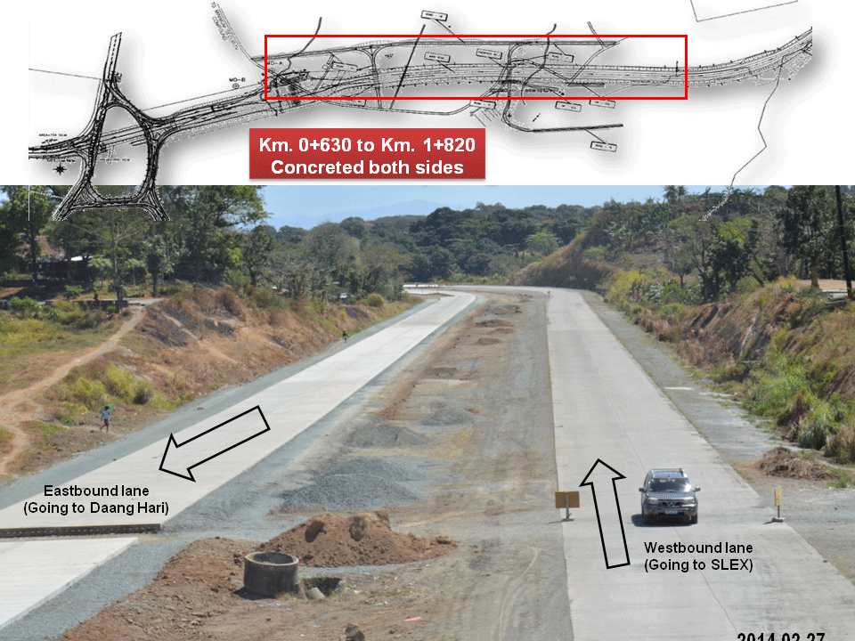
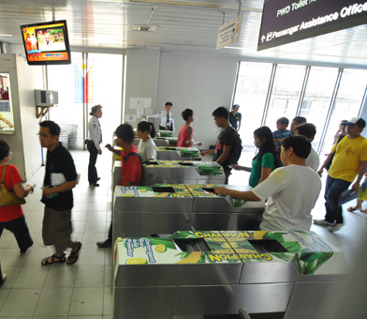
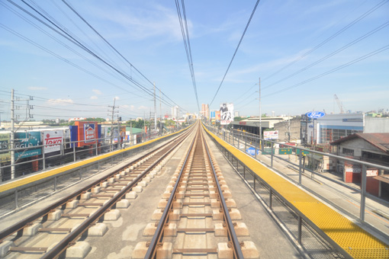
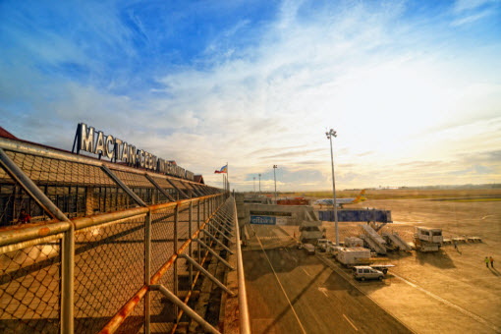
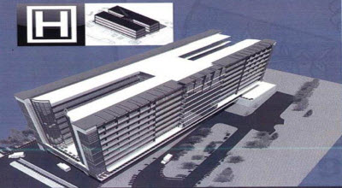
Public Private Partnership Projects
WB ranks Philippines in top 10
Program largely dormant 1998-2010
$100 million in Project Development Fund
Eight projects awarded worth $3 billlion
13 projects targeted for bidding by 2016 worth $12.28 billion

Slide 24
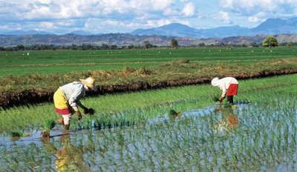
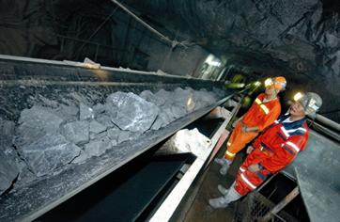
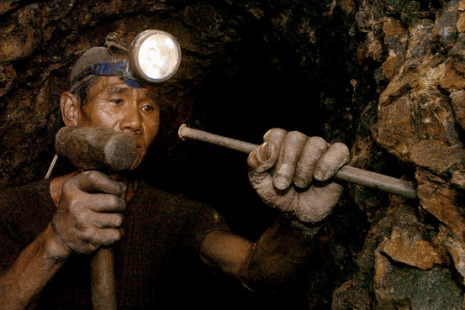
Two Low-Growth High Potential Sectors
Agriculture
  30% of population
  Undercapitalized
  CARP-ER-ER
  Low productivity
  High costs
  Bangsamoro
Mining
  New mining projects suspended
  EO 71 July 2012
  Seeks uncompetitive fiscal regime
  Extensive No-Go zones
  Ban ore exports

Slide 25
The Economy Should Be All About Jobs

Slide 26




Policy Reforms
GOCC Reform
RH Law
K-12
Universal Healthcare
ACT/Higher Taxes on cigarettes
Foreign Bank Act

Slide 27

More Policy Reforms
Bangsamoro Act
Build-Operate-Transfer Act amendments
Customs Modernization and Tariff Act
Competition Act
Foreign Equity constitutional amendments
Foreign Investment Negative list amendments
Freedom of Information Act
Sandiganbayan Reform

Slide 28


Other Challenges
Bureaucracy/red tape
Business Costs – labor, power, taxes
Corruption persistence and recidivism
Judicial Convictions
Judicial Reform
Security – internal
Trade Policy – TPP, RCEP, EU-FTA
Poor Infrastructure

Slide 29
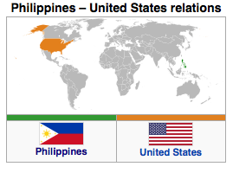
Wide Impact: a Middle Income Economy and US partner
Middle Income Economy
  At 7.5% growth, a GDP of $1 trillion by 2030
  Population of 130 million and PCI near $8,000
  2nd or 3rd largest ASEAN economy
  Global diaspora
  Regional MNCs
  Hub for US BPO and manufacturing
Stronger US partner
  Democratic values
  Strong people and historical links
  Largest English-speaking Asian country
  US treaty ally

Slide 30
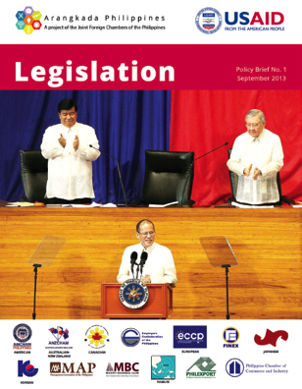


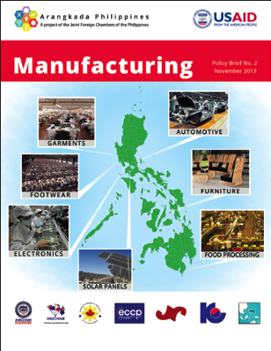



Arangkada Advocacy Documents
2010 Policy Paper and Anniversary Assessments
Policy Briefs

Slide 31
Arangkada Website
Check our website: www.investphilippines.info/arangkada/
Subscribe to our clips: www.investphilippines.info/arangkada/newsclips/
THANK YOU!
A Project of AmCham with USAID and the Joint Foreign Chambers

